Slide 1
Important Note Regarding This Microsoft PowerPoint Presentation
* Do not include this slide in your presentation *
This slide deck has been intentionally provided with very limited graphics and formatting to simplify content integration into your own preferred PowerPoint themes and styles.

Slide 2
Security Development Lifecycle (SDL) Field Content
Fuzz Testing
(Level 200)

Slide 3
Agenda
Overview of the Microsoft SDL
Overview of fuzz testing
Smart
Dumb
How to fuzz test an application
File format parsers
Network parsers
Other types of parsers
Microsoft SDL fuzz testing requirements and recommendations

Slide 4

Microsoft Security Development Lifecycle (SDL)
Training
Requirem-ents
Design
Implemen-tation
Verification
Release
Response
Delivering secure software requires:
Executive commitment → SDL a mandatory policy at Microsoft since 2004
Education
Technology and Process
Accountability
Ongoing Process Improvements → 6 month cycle

Slide 5
Fuzz Testing Overview
Fuzz Testing: Inputting malformed data into an application and analyzing the application’s reaction to the malformed data
If the application fails then a potential vulnerability has been found
Core Microsoft SDL Verification Phase testing technique
Targets code, called parsers, that analyze data structures, such as:
File format parsers
Network protocol parsers
Other types of parsers

Slide 6



Fuzz Testing Illustrated
0110101010
Application
1234554321
ABCD!
Valid user
Malicious user

Slide 7
Fuzz Testing Advantages and Disadvantages
Advantages
Vulnerabilities identified are usually very severe in nature
Highly automatable testing technique
Disadvantages
Will not identify vulnerabilities that do not cause an exception (e.g. information disclosure cryptography, etc.)
Fuzz testing should not replace other assessment activities, and certainly is not to be considered a “silver bullet”

Slide 8
Fuzz Testing Techniques
Two types of fuzz testing techniques:
Dumb fuzz testing
Randomly changing data that is inputted into an application
Smart fuzz testing
Changing specific values leveraging knowledge of underlying format and/or expected behavior

Slide 9
Smart versus Dumb Fuzz Testing
Example: An application that reads telephone numbers in the format (AAA) BBB - CCCC
Dumb Fuzz Testing Malformed Data | Kevin, 123, Microsoft, Internet, SQLServer, k3v1n11, AAAAAAAAAAA, 00000_, !@#%^
Smart Fuzz Testing Malformed Data | (AAA) 123-4567, (123) 123*1234, (000 123-4567, (<empty>)123-4567, (123) 456---5678, ((123)4567890,(AAAAAAAA) 123-4567, (<U+07C0>23) 123-4579

Slide 10
How to Perform Fuzz Tests
Generic methodology for fuzz testing:
Determine entry points into an application
Rank entry points by privilege and accessibility
Create and input malformed data into applications for at-risk entry points
Whenever possible, use tools to automate fuzz testing
Analyze any unexpected or unhandled crashes, exceptions and errors in order to identify severe vulnerabilities in code.
Fix and re-test
http://blogs.msdn.com/sdl/archive/2007/09/20/fuzz-testing-at-microsoft-and-the-triage-process.aspx

Slide 11
Fuzz Testing File Format Parsers
Methodology for fuzz testing file formats:
Identify supported file formats
Create a library of valid files
Create malformed variations
Input the malformed file into an application and observe how the application behaves
http://blogs.msdn.com/sdl/archive/2007/09/20/fuzz-testing-at-microsoft-and-the-triage-process.aspx

Slide 12
File Format Parser Fuzz Testing Demonstration

Slide 13

Fuzz Testing Network Parsers
Create malformed network packets
Record-fuzz-replay network packets
Create malformed network packets on the fly
Fuzz Testing Tool
Malformed network traffic
Application
User
Valid network traffic
Application
Fuzz Testing Tool
Malformed network traffic
User
Valid Network Traffic
Fuzz Testing Tool
Malformed Network Traffic
Application

Slide 14
Fuzz Testing Other Types of Parsers
General security best practice: any un-trusted entry point into an application should be fuzz tested
Other customer code that reads, consumes and analyzes data from un-trusted sources are typically susceptible to attack:
ActiveX controls
Mobile code (Java, Flash, Silverlight, etc.)
Code hosted in a browser
Other entry points, such as command-line arguments and user interfaces (UIs)

Slide 15
Fuzz Testing Tools
Microsoft AppVerifier
Refer to http://technet.microsoft.com/en-us/library/bb457063.aspx for more information
Microsoft SDL Book MiniFuzz
Refer to http://www.microsoft.com/mspress/books/8753.aspx for more information
Freely available tools
Conduct a search engine search on “fuzzing tools”

Slide 16
Microsoft SDL Fuzz Testing Requirements
Fuzz testing is required on retail (not debug) builds of an application
Fuzz testing must be performed during Microsoft SDL Verification Phase for all:
Supported file formats
Remote Procedure Call (RPC) interfaces
ActiveX controls
Re-fuzz test application after updates or changes to parsers
For each file format, 100,000 different malformed files must be tested
Must repeat this process each time a vulnerability is identified

Slide 17
Microsoft SDL Fuzz Testing Recommendations
Keep all malformed files that cause applications to fail
Perform network fuzz testing on private sub-networks
Combine fuzz testing with other effective security testing techniques, such as security code review
Dedicate a small number of machines for fuzz testing
Intensively investigate all fuzz testing errors

Slide 18
Conclusion
Overview of fuzz testing
Methodologies and techniques for fuzz testing common parsers
Fuzz testing pros and cons
Microsoft SDL fuzz testing requirements and recommendations

Slide 19
Appendix

Slide 20





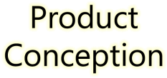
































Microsoft Security Development Lifecycle (SDL)
SDL Book:
http://www.microsoft.com/mspress/books/8753.aspx
Official SDL Web Site: http://www.microsoft.com/sdl

Slide 21


Microsoft Writing Secure Code Book Series
Writing Secure Code,
2nd Edition:
http://www.microsoft.com/mspress/books/5957.aspx
Writing Secure Code for Windows Vista:
http://www.microsoft.com/mspress/books/10723.aspx

Slide 22
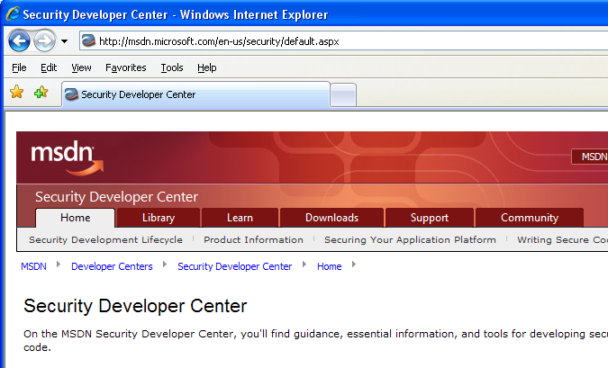

Microsoft Developer Network (MSDN) Security Developer Center
Official Web site: http://msdn.microsoft.com/security

Slide 23
Secure Development Blogs
The Microsoft Security Development Lifecycle (SDL) Blog: http://blogs.msdn.com/sdl
Michael Howard’s Blog: http://blogs.msdn.com/michael_howard

Slide 24
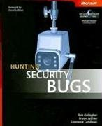
Microsoft Hunting Security Bugs
Hunting Security Bugs:
http://www.microsoft.com/mspress/books/8485.aspx

Slide 25
Additional SDL Training Content
Secure Design Principles
Secure Implementation Principles
Secure Verification Principles
SQL Injection Vulnerabilities
Cross-Site Scripting Vulnerabilities
Buffer Overflow Vulnerabilities

Slide 26
Additional Fuzz Testing Resources
Fuzz Testing at Microsoft (Scott Lambert):
http://blogs.msdn.com/sdl/archive/2007/09/20/fuzz-testing-at-microsoft-and-the-triage-process.aspx
Triaging crashes:
http://msdn.microsoft.com/en-us/magazine/cc163311.aspx
http://download.microsoft.com/download/7/2/8/728FE40F-93B6-47BD-B67D-78D04B63E27D/Automated%20Security%20Crash%20Dump%20Analysis.pptx
http://www.microsoft.com/security/msec/default.mspx
Automated Penetration Testing With White-Box Fuzzing
http://msdn.microsoft.com/en-us/library/cc162782.aspx

